Slide 1


C++

Slide 2
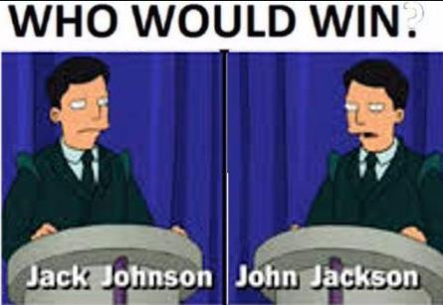
Variable types, control flow, loops, functions
IDENTICAL
Notes:
Not all languages have types, those that do are considered type-safe. Those without can become dicey at times
https://www.w3schools.com/cs/exercise.php?filename=exercise_variables1
https://www.w3schools.com/cs/exercise.php?filename=exercise_data_types1 // => all except 4. Casting explain live

Slide 3
References and Pointers
Per W3Schools:
References and Pointers are important in C++, because they give you the ability to manipulate the data in the computer's memory - which can reduce the code and improve the performance.
These two features are one of the things that make C++ stand out from other programming languages, like Python and Java.
Notes:
Not all languages have types, those that do are considered type-safe. Those without can become dicey at times
https://www.w3schools.com/cs/exercise.php?filename=exercise_variables1
https://www.w3schools.com/cs/exercise.php?filename=exercise_data_types1 // => all except 4. Casting explain live

Slide 4
References and Pointers
EXAMPLES
Notes:
Not all languages have types, those that do are considered type-safe. Those without can become dicey at times
https://www.w3schools.com/cs/exercise.php?filename=exercise_variables1
https://www.w3schools.com/cs/exercise.php?filename=exercise_data_types1 // => all except 4. Casting explain live

Slide 5
Unreal
CROUCHMAN
Notes:
Not all languages have types, those that do are considered type-safe. Those without can become dicey at times
https://www.w3schools.com/cs/exercise.php?filename=exercise_variables1
https://www.w3schools.com/cs/exercise.php?filename=exercise_data_types1 // => all except 4. Casting explain live

